Slide 1
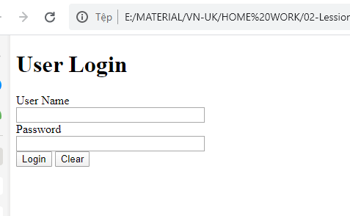
Activity
Notes:
<!DOCTYPE html>
<html> <head>
<title>User Login</title>
</head> <body>
<h1>User Login</h1>
<div>
<label>User Name
<br />
<input type="text" size="32" id="txt1" />
</label>
</div>
<div>
<label>
Password <br />
<input type="password" size="32" id="txt2" />
</label>
</div>
<div>
<button type="button" onclick="login()">Login</button>
<button type="button" onclick="cancel()">Clear</button>
</div>
<div id="sms"></div>
<script type="text/javascript">
// arrays of user names and passwords
var usernames = ["admin","author","guest"];
var passwords = ["321","abc", "xyz"];
// user name is : admin
// password is: 123
function login()
{
// get user name from user input
var username = document.getElementById("txt1").value;
// get password from user input
var password = document.getElementById("txt2").value;
// a variable to store error message
var sms = "";
// loop through the usernames
for(var i=0;i<usernames.length;i++)
{
if(username==usernames[i])
{
sms="";
// compare password for the correct username
if(password==passwords[i])
{
// redirect user to google.com
location.href="http://www.google.com";
}
else{
sms ="Invalid password!";
}
break; // exit the loop
}
else{
sms ="Invalid username!";
}
}
document.getElementById("sms").innerHTML = sms;
}
// clear the form when user hit on clear button
function cancel()
{
document.getElementById("txt1").value="";
document.getElementById("txt2").value="";
document.getElementById("txt1").focus();
}
</script>
</body></html>

Slide 2
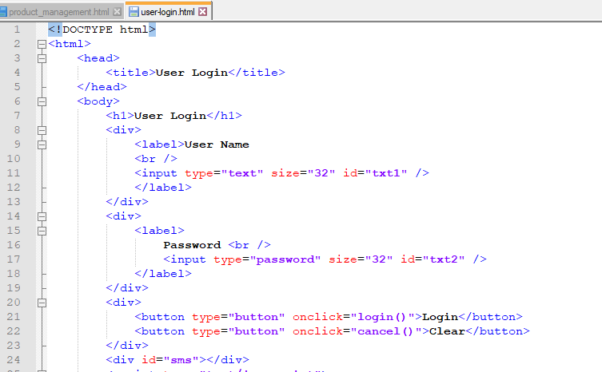

Slide 3
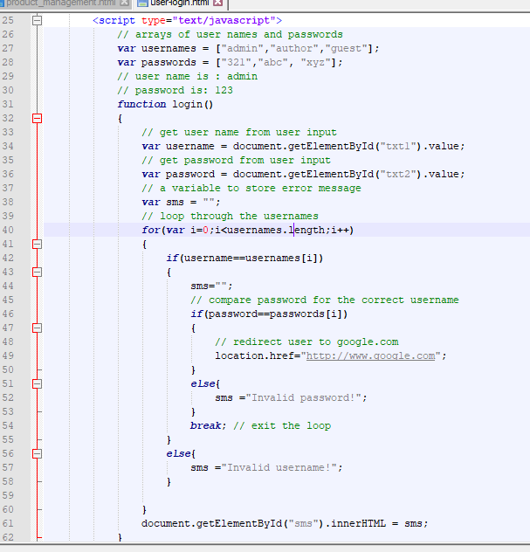

Slide 4
